Slide 1
E-LEARNING
TAINGUYEN-MEUMOC
MENTORSHIP_PROGRAM

Slide 2
AGENDA
I. OUTLINE
II. ANALYSIS

Slide 3

I. OUTLINE
1. USE CASE
2. DATABASE
3. UI/UX

Slide 4
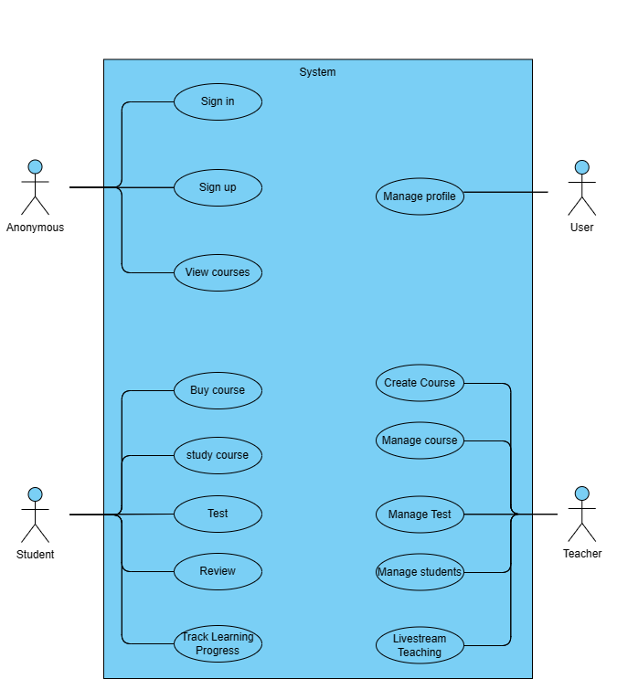

Slide 5
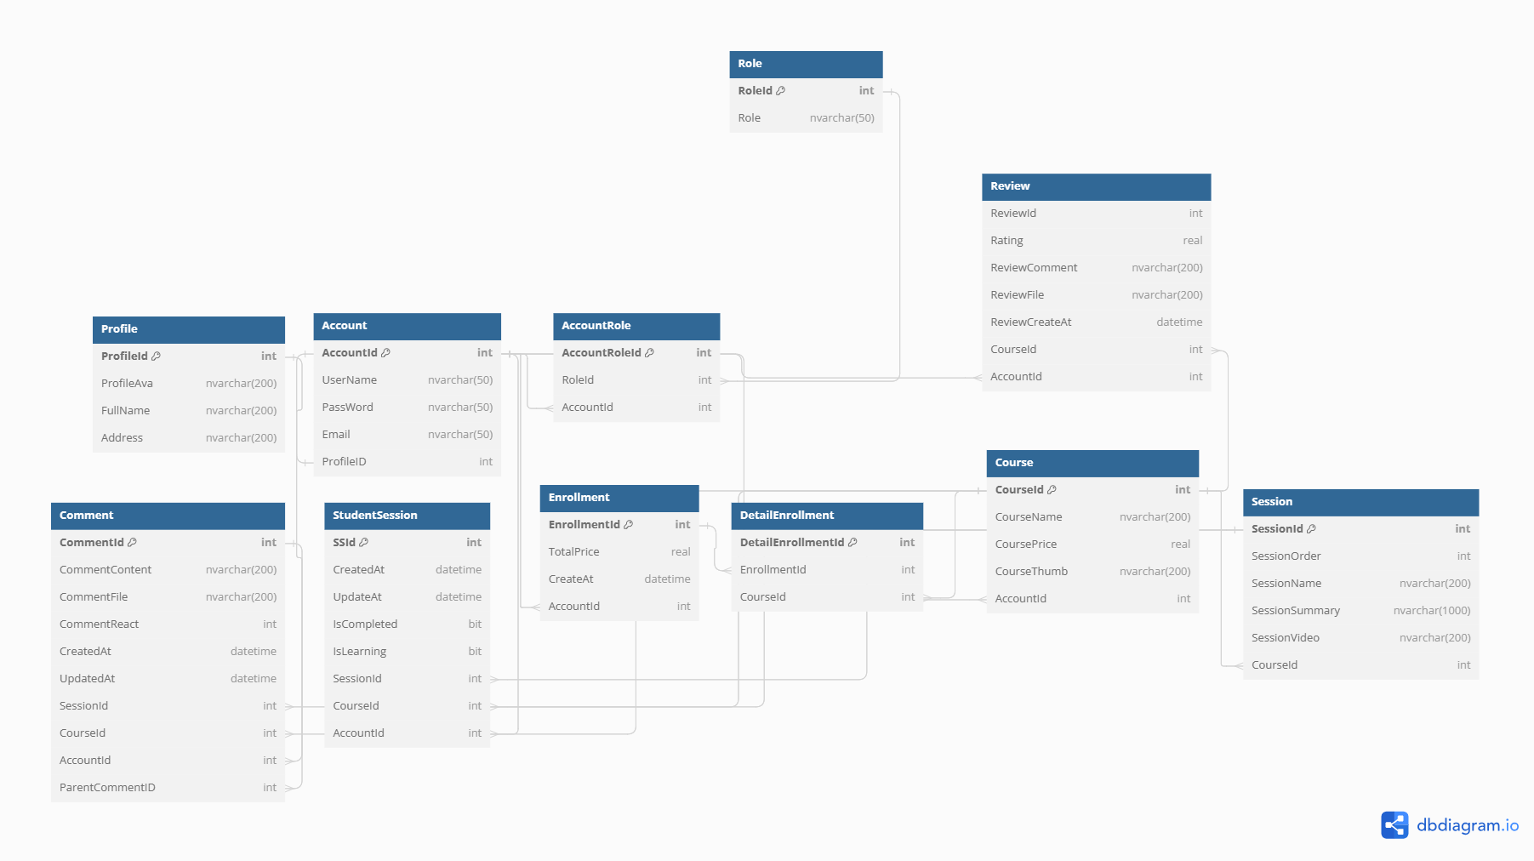

Slide 6


Slide 7
II. ANALYSIS
1. TEST DATA
2. SELECT DATA

Slide 8


1.TEST DATA

Slide 9
INSERT INTO [Profile] ([ProfileId], [ProfileAva], [FullName], [Address])
VALUES
(1, 'profile1.jpg', 'John Doe', '123 Main Street'),
(2, 'profile2.jpg', 'Tai', '3333 Main Street'),
(3, 'profile3.jpg', 'Jane Smith', '456 Elm Street');
-- Inserting sample data into the [Role] table
INSERT INTO [Role] ([RoleId], [Role])
VALUES
(1, 'Student'),
(2, 'Teacher'),
(3, 'Admin');

Slide 10
INSERT INTO [Account] ([AccountId], [UserName], [PassWord], [Email], [ProfileID])
VALUES
(1, 'john_doe', 'password123', 'john@example.com', 1),
(2, 'tai123', 'password123', 'tai@example.com', 2),
(3, 'jane_smith', 'password456', 'jane@example.com', 3);
-- Inserting sample data into the [AccountRole] table
INSERT INTO [AccountRole] ([AccountRoleId], [RoleId], [AccountId])
VALUES
(1, 1, 1),
(2, 3, 1),
(3, 2, 2),
(4, 2, 3);

Slide 11
INSERT INTO [Course] ([CourseId], [CourseName], [CoursePrice], [CourseThumb], [AccountId])
VALUES
(1, 'Introduction to Programming', 49.99, 'course1_thumb.jpg', 3),
(2, 'Web Development Basics', 29.99, 'course2_thumb.jpg', 3),
(3, 'UI', 59.99, 'course3_thumb.jpg', 3);
-- Inserting sample data into the [Enrollment] table
INSERT INTO [Enrollment] ([EnrollmentId], [TotalPrice], [CreateAt], [AccountId])
VALUES
(1, 49.99, GETDATE(), 1),
(2, 29.99, GETDATE(), 2);

Slide 12
INSERT INTO [DetailEnrollment] ([DetailEnrollmentId], [EnrollmentId], [CourseId])
VALUES
(1, 1, 1),
(2, 1, 2),
(3, 2, 1),
(4, 2, 3);
-- Inserting sample data into the [Session] table
INSERT INTO [Session] ([SessionId], [SessionOrder], [SessionName], [SessionSummary], [SessionVideo], [CourseId])
VALUES
(1, 1, 'Introduction to Programming Concepts', 'Basic concepts of programming', 'video1.mp4', 1),
(2, 2, 'Variables and Data Types', 'Introduction to variables and data types', 'video2.mp4', 1),
(3, 1, 'UI', 'Introduction to UI', 'video2.mp4', 3),
(4, 1, 'HTML CSS', 'Introduction to HTML CSS', 'video3.mp4', 2);

Slide 13
INSERT INTO [StudentSession] ([SSId], [CreatedAt], [UpdateAt], [IsCompleted], [IsLearning], [SessionId], [CourseId], [AccountId])
VALUES
(1, GETDATE(), GETDATE(), 1, 0, 1, 1, 1),
(2, GETDATE(), GETDATE(), 0, 1, 2, 1, 1),
(3, GETDATE(), GETDATE(), 1, 0, 1, 1, 2),
(4, GETDATE(), GETDATE(), 0, 1, 3, 3, 2);
-- Inserting sample data into the [Review] table
INSERT INTO [Review] ([ReviewId], [Rating], [ReviewComment], [ReviewFile], [ReviewCreateAt], [CourseId], [AccountId])
VALUES
(1, 4.5, 'Great course, learned a lot!', NULL, GETDATE(), 1, 1),
(2, 3.5, 'Not bad!', NULL, GETDATE(), 2, 1),
(3, 5.0, 'Excellent content, highly recommended!', NULL, GETDATE(), 1, 2);

Slide 14
INSERT INTO [Comment] ([CommentId], [CommentContent], [CommentFile], [CommentReact], [CreatedAt], [UpdatedAt], [SessionId], [CourseId], [AccountId], [ParentCommentID])
VALUES
(1, 'How can...?', NULL, 10, GETDATE(), GETDATE(), 1, 1, 1, NULL),
(2, 'How can...?', NULL, 10, GETDATE(), GETDATE(), 4, 2, 1, NULL),
(3, 'Answer is abc.', NULL, 5, GETDATE(), GETDATE(), 1, 1, 2, 1);

Slide 15
2. SELECT DATA

Slide 16
II. ANALYSIS
1. NAME COURSE, TEACHER, AVG RATING
2. SESSION
3. TRACKING PROGRESS
4. REVIEW

Slide 17
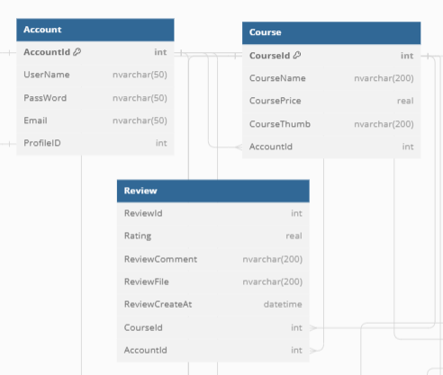

1. NAME COURSE, TEACHER, AVG RATING

Slide 18
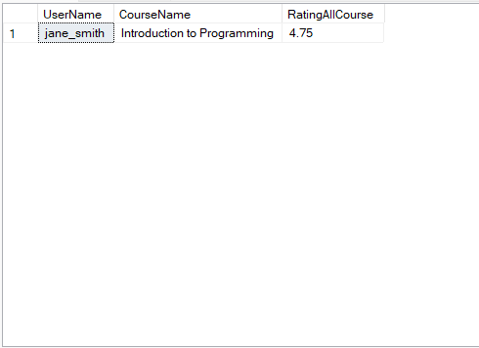
-- Select Name of Teacher, their name of course and rating of their course in Course's student with their choice IdCourse =1
Select a.UserName,c.CourseName,AVG(r.Rating) as 'RatingAllCourse'
From Account a
Join Course c on c.AccountId=a.AccountId
Join Review r on r.CourseId = c.CourseId
Where c.CourseId=1
Group by a.UserName,c.CourseName

Slide 19
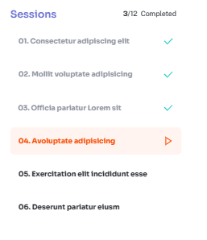
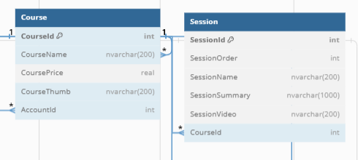
2. SESSION

Slide 20
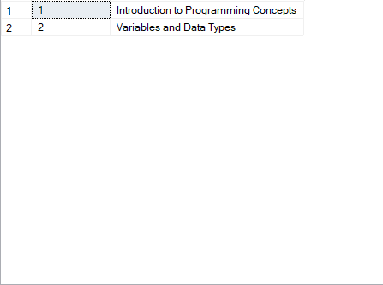
-- Select SessionOrder Name Session with CourseId=1
Select s.SessionOrder,s.SessionName
From Course c
Join Session s on s.CourseId=c.CourseId
Where c.CourseId=1
Group by s.SessionOrder,s.SessionName

Slide 21
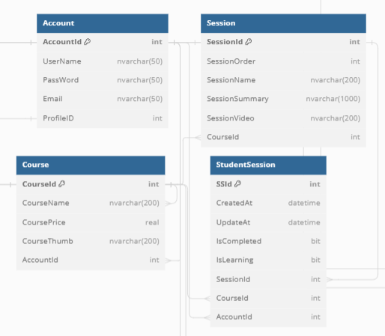
3. TRACKING PROGRESS

Slide 22

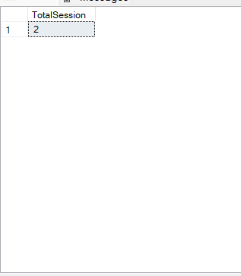
3.1 TOTAL SESSION
-- Select Total Session of course with CourseId=1
Select count(s.SessionId)as 'TotalSession'
From Account a
Join Course c on c.AccountId=a.AccountId
Join Session s on s.CourseId = c.CourseId
where c.CourseId=1

Slide 23
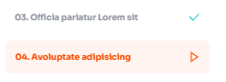
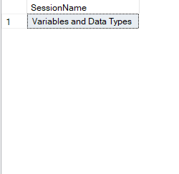
3.2 TRACK PROGRESS
-- Select Progress of student with AccountId=1 and ss.Islearning=1
Select s.SessionName
From Session s
Join StudentSession ss on s.SessionId=ss.SessionId
Where ss.IsLearning=1 and ss.AccountId=1

Slide 24
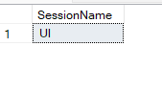
3.2 TRACK PROGRESS
-- Select Progress of student with AccountId=2 and ss.Islearning=1
Select s.SessionName
From Session s
Join StudentSession ss on s.SessionId=ss.SessionId
Where ss.IsLearning=1 and ss.AccountId=2

Slide 25
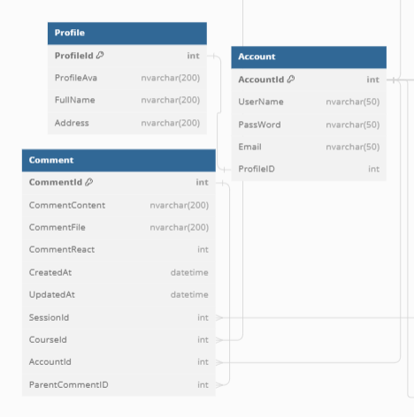

4. REVIEW

Slide 26
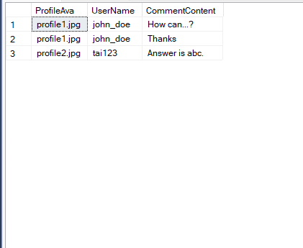
3. REVIEW
-- Select Review of Course with c.SessionId=1
Select p.ProfileAva,a.UserName,c.CommentContent
From Comment c
join Account a on a.AccountId=c.AccountId
join Profile p on a.ProfileID=p.ProfileId
Where c.SessionId=1
Group by p.ProfileAva,a.UserName,c.CommentContent

Slide 27
THANKS FOR READING

